Slide 1
CONIC SECTIONS

Slide 2
SPECIFIC OBJECTIVES:
At the end of the lesson, the student is expected to be able to:
• give the properties of hyperbola.
• write the standard and general equation of a hyperbola.
• sketch the graph of hyperbola accurately.

Slide 3
THE HYPERBOLA (e > 1)
A hyperbola is the set of points in a plane such that the difference of the distances of each point of the set from two fixed points (foci) in the plane is constant.
The equations of hyperbolas resemble those of ellipses but the properties of these two kinds of conics differ considerably in some respects.
To derive the equation of a hyperbola, we take the origin midway between the foci and a coordinate axis on the line through the foci.

Slide 4
The following terms are important in drawing the graph of a hyperbola;
Transverse axis (2a) is a line segment joining the two vertices of the hyperbola.
Conjugate axis (2b) is the perpendicular bisector of the transverse axis.
General Equations of a Hyperbola
1. Horizontal Transverse Axis : Ax² – Cy² + Dx + Ey + F = 0
2. Vertical Transverse Axis: Cy² – Ax² + Dx + Ey + F = 0

Slide 5
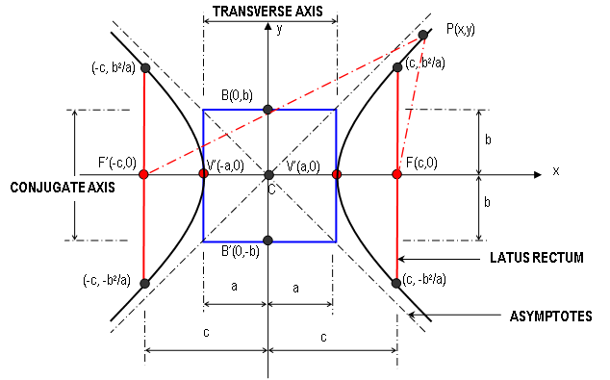
HYPERBOLA WITH CENTER AT THE ORIGIN C(0,0)

Slide 6






Then letting b² = c² – a² and dividing by a²b², we have
if foci are on the x-axis
if foci are on the y-axis
The generalized equations of hyperbolas with axes parallel to the coordinate axes and center at (h, k) are
if foci are on a axis parallel to the x-axis
if foci are on a axis parallel to the y-axis

Slide 7
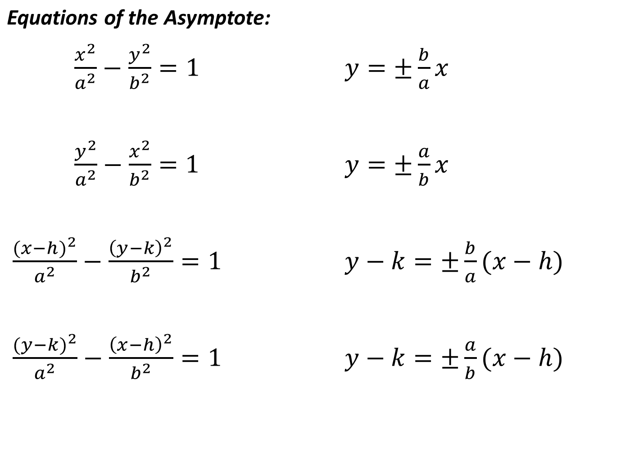

Slide 8
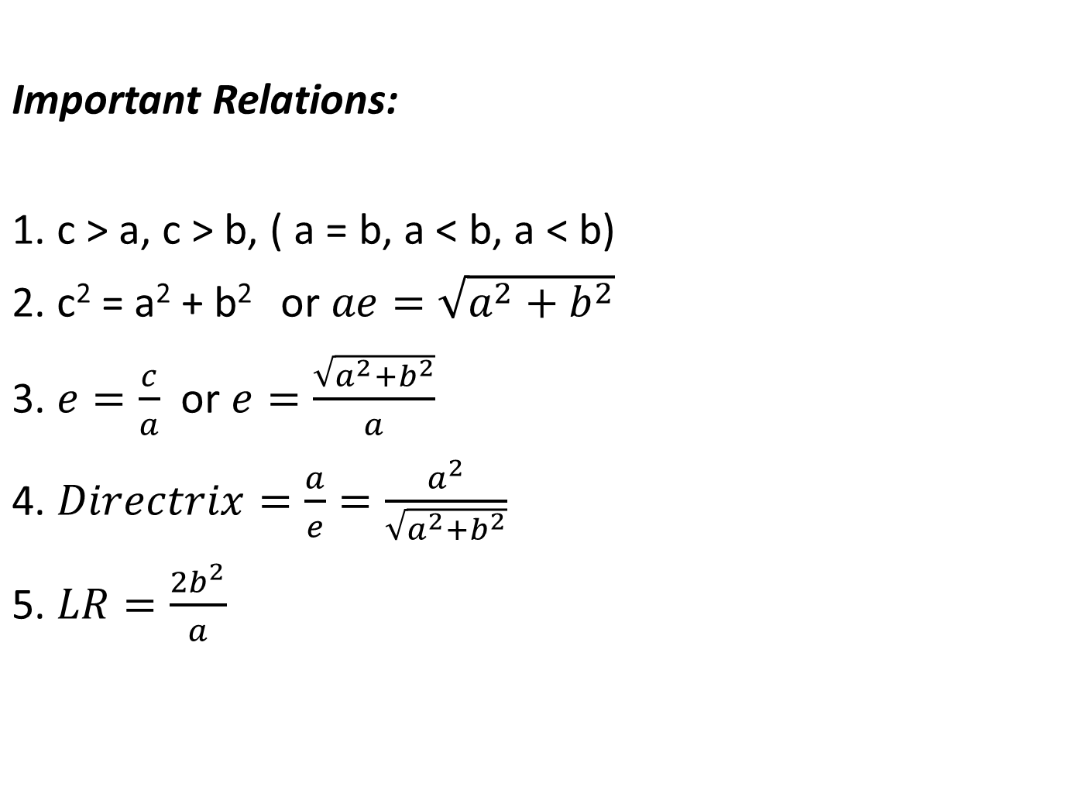

Slide 9
Sample Problems:
1. Find the equation of the hyperbola which satisfies the given conditions:
Center (0,0), with axes parallel to the coordinate axes, latus rectum is 18 and the distance between foci is 12.
b. Center (0,0), transverse axis along the x-axis, e=sqrt7/2 and latus rectum is 6.
2. Sketch the graph of the hyperbola:
9x² -16y² -576 = 0
4x² -9y² - 48x + 72y +144 = 0

Slide 10
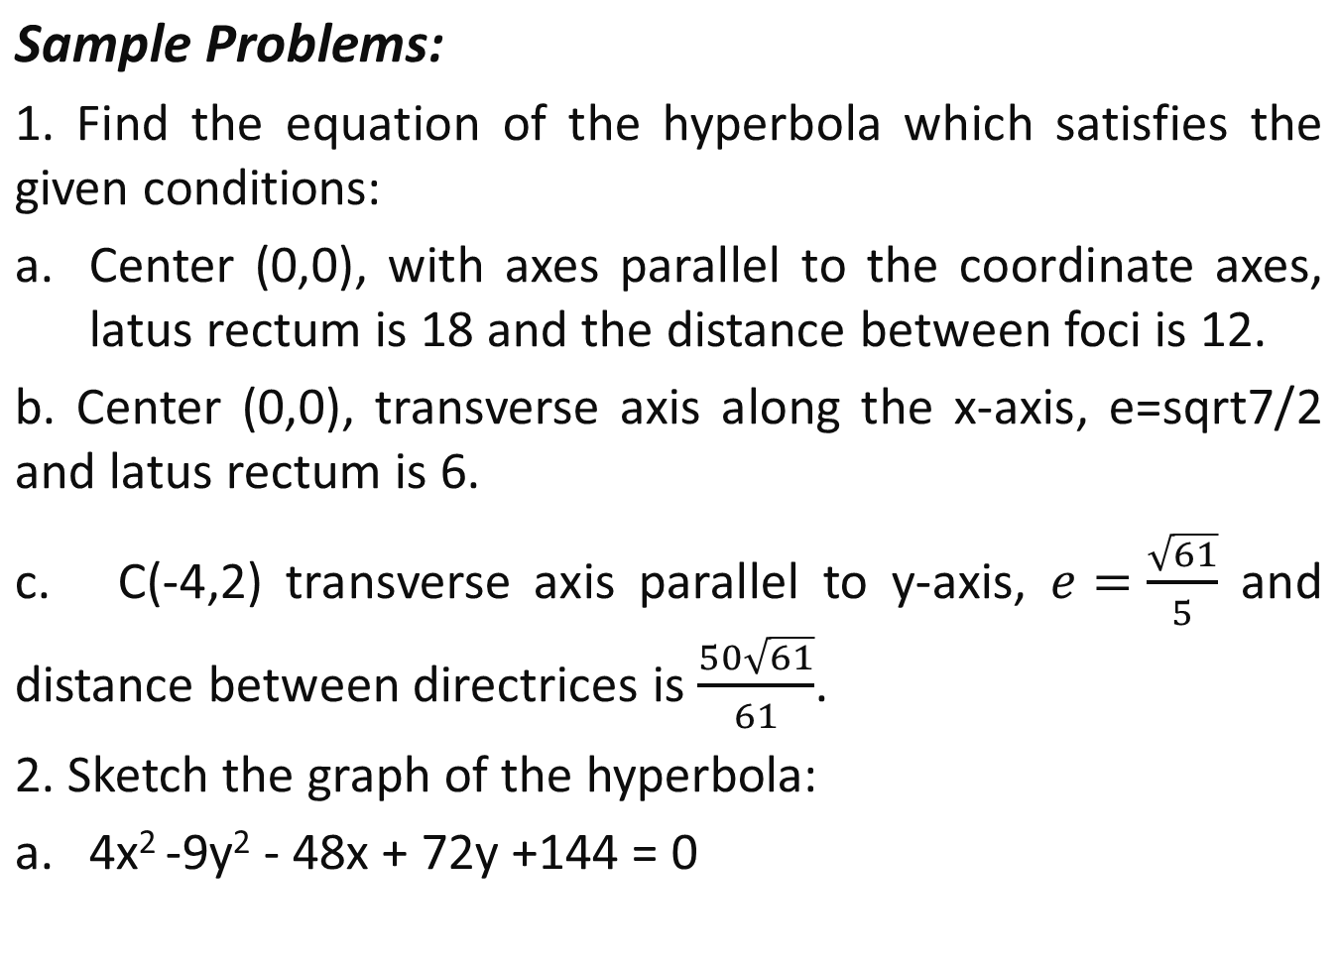

Slide 11
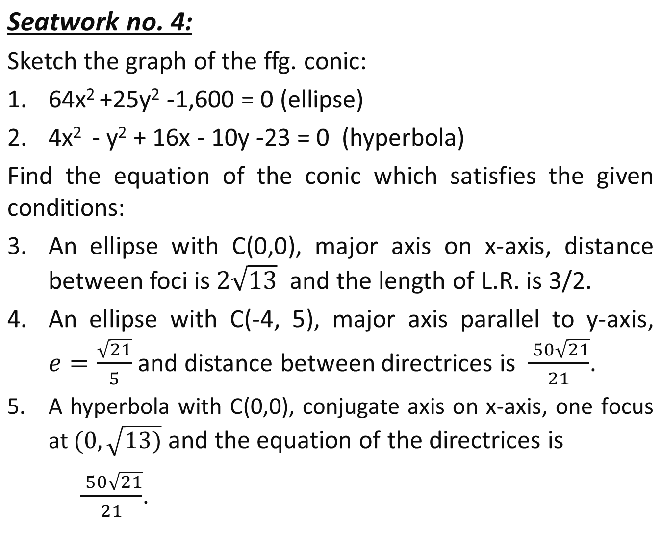

Slide 12
e. Center (-3,2), transverse axis parallel to the y-axis, passing through (1,7), the asymptotes are perpendicular to each other.
f. Center (0,6), conjugate axis along the y-axis, asymptotes are 6x – 5y + 30 = 0 and 6x + 5y – 30 = 0.
2. Reduce each equation to its standard form. Find the coordinates of the center, the vertices and the foci. Draw the asymptotes and the graph of each equation.
a. 9x² –4y² –36x + 16y – 16 = 0
b. 49y² – 4x² + 48x – 98y - 291 = 0

Slide 13
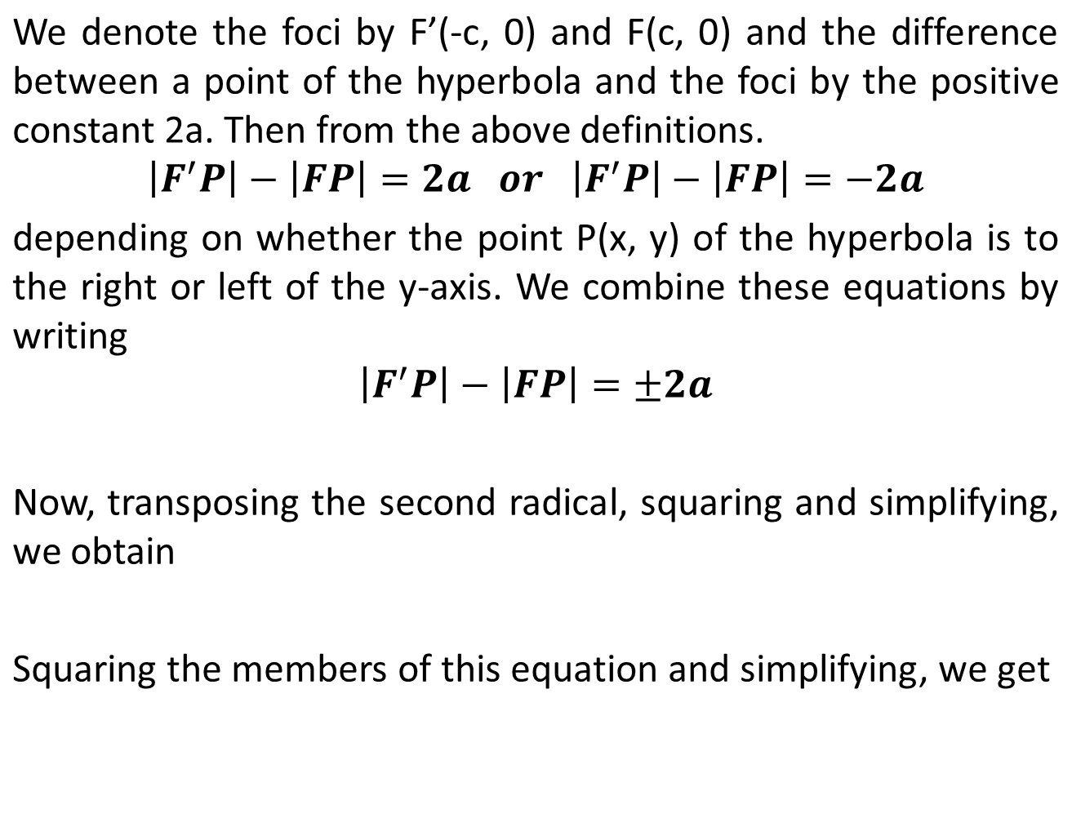



Slide 14
SPECIAL PROPERTIES AND APPLICATIONS
1. When an airplane flies at a speed faster than the speed of sound, it creates a shock waves heard as a sonic bomb in the shape of a cone and it intersects the ground in a curve which is hyperbolic in shape.
2. In Long Range Navigation (LORAN) this constant difference is utilized in finding the location of a navigator.

Slide 15
e. Center (-3,2), transverse axis parallel to the y-axis, passing through (1,7), the asymptotes are perpendicular to each other.
f. Center (0,6), conjugate axis along the y-axis, asymptotes are 6x – 5y + 30 = 0 and 6x + 5y – 30 = 0.
2. Reduce each equation to its standard form. Find the coordinates of the center, the vertices and the foci. Draw the asymptotes and the graph of each equation.
a. 9x² –4y² –36x + 16y – 16 = 0
b. 49y² – 4x² + 48x – 98y - 291 = 0

